Slide 1

Introduction to Cloud Storage
Kevin Luu
Virtualization and Cloud Specialist
Kevin.luu@northwestern.edu
Brian Roland
Data Management Specialist
Brian.roland@northwestern.edu
Research Computing
& Data Services

Slide 2
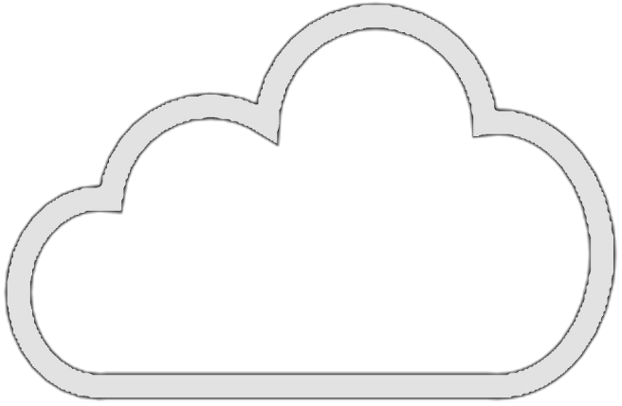
After this session, you will be able to...
Learn the advantages of getting a Northwestern cloud account and how to request one.
Understand what cloud object storage is and why you would use it
Perform the following tasks
Create and configure storage
Upload objects into the cloud using the Console, and CLI

Slide 3

What - is the cloud?
Using the cloud is like renting IT hardware in someone else's data center.
On-demand computing and data storage resources
Resources are flexible & scalable
Pay for what you use

Slide 4
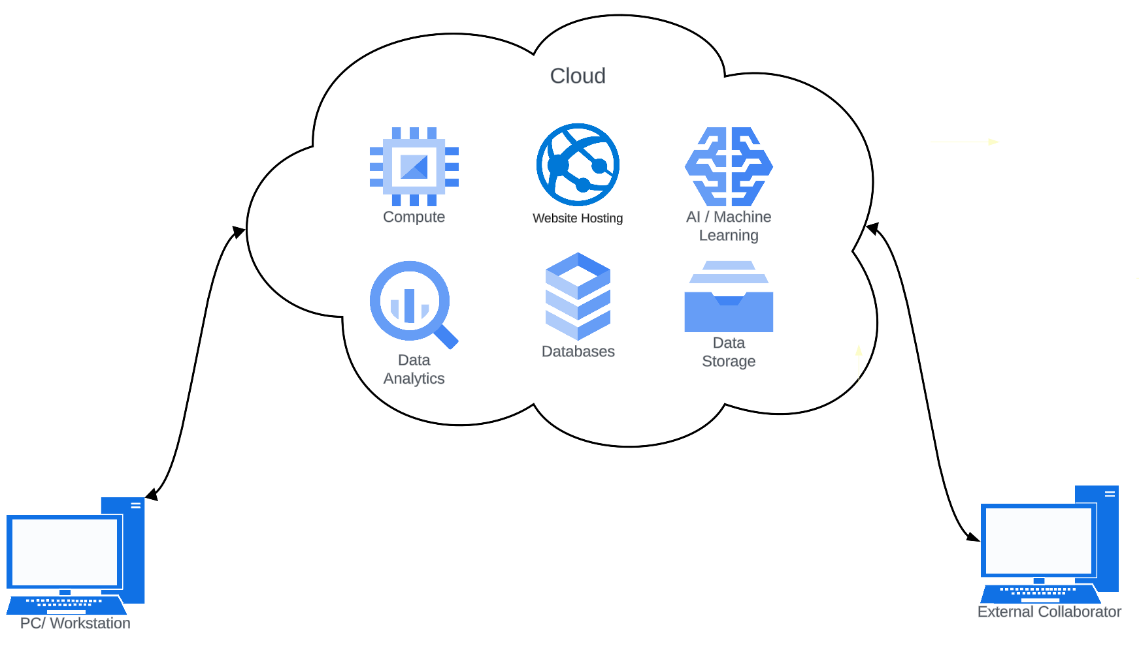
Cloud Overview

Slide 5
Does this sound familiar ?
Is the cost of your current data storage currently too expensive ?
Do you need more control of your files and folder such as who can read and write on them?
Do you have too many old data that should be archived?
Cloud Storage could be the solution.

Slide 6
Why - Cloud Storage
Cloud Storage if properly configured can result in lower costs.
If you need granular permission on folders/ file you can create polices can on your storage to limit who has access.
You can control spending by putting data into cheaper storage tiers designed for long term storage.

Slide 7
When - should you consider using Cloud?
Easy Access Anywhere: With cloud storage, researchers and collaborators can reach their files from any device with an internet connection.
Scalable: If you're uncertain about the required processing power or storage, the flexibility of the cloud makes it easy to scale up or down as needed.
Vendor Support: Unlike manually managing your current data management systems, here at Northwestern University we have a dedicated support across departmental IT and Vendors.

Slide 8
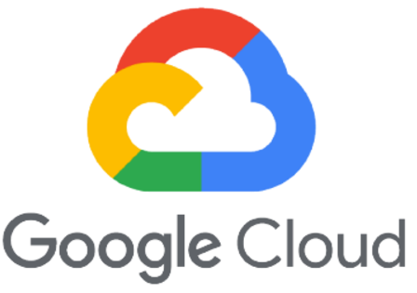


Cloud Providers
Amazon
Largest of the 3 platform
Extensive global infrastructure
Microsoft
Intergration of Microsoft's ecosystems like Office 365
Access to OpenAI Models
Google
Considered to be a leader in data analytics tools and services
Integrates with Google's ecosystem (Google Drive, Collab)
Each cloud providers in general do have the same services such as Virtual machines and Storage.
Here at Northwestern in terms of popularity AWS>Azure>Google

Slide 9
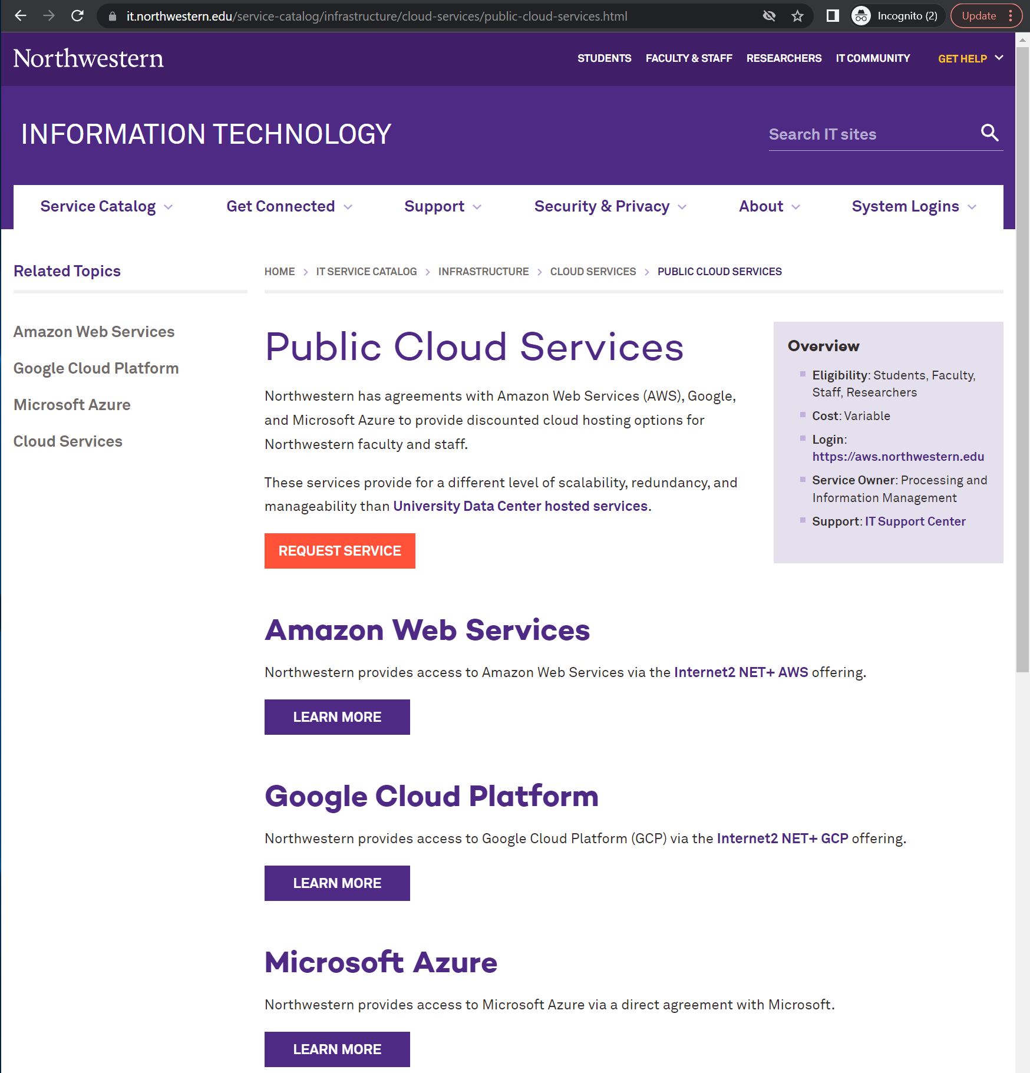
Where to Start at Northwestern
Public Cloud Services
Northwestern has agreements with AWS, GCP, Azure to provide benefits for cloud hosting options
Available to NU faculty, researchers and staff
You will need a Blanket PO
Request Public Cloud Account

Slide 10
Northwestern Cloud Benefits
Amazon Web Services (AWS) | Google Cloud Platform (GCP) | Azure
Direct billing to chart strings in NU Financials A waiver of data egress fees for most applications Single sign-on with Northwestern credentials Discount of 5%-10% for services HIPAA-compliant environments
NU cloud account, are setup with alerts ensure proper usage such notifying you when there is suddenly a large charges or improper configuration.

Slide 11
STRIDES
If your project is funded by a NIH Grant, you may be able eligible for additional benefits through STRIDES Link
Amazon Web Services (AWS) | Google Cloud Platform (GCP)
9% discount on all AWS services except S3 and Marketplace 14% discount on AWS S3 storage services (except Glacier Deep Archive) Free access to enterprise-level AWS support (Documentation) | 25% off compute and standard storage 10% off coldline and archive storage 19% off managed services such as BigTable and BigQuery

Slide 12


Object Storage
Inexpensive
Pay only for what you use
Scalable
Theoretically unlimited
Accessible
Web portal, Globus, CLI
Sharing data
Long Term Storage
Great for storing data long term for cheap.
In object storage, The data you upload are referred to as a object and each object includes the data itself, metadata/s, and a unique identifier.

Slide 13
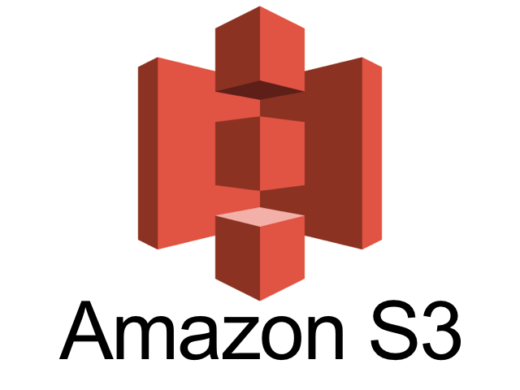
AWS - Simple Storage Service (S3)

Slide 14
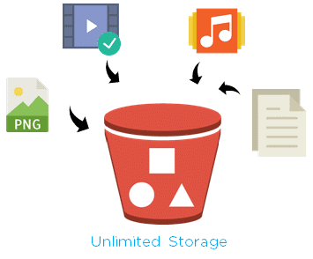
What makes a bucket?
Bucket – a container that stores objects
Object - Any data type + Tag
Tag – An optional identifier you can set for organization
Any File that has an extension that can be opened from a file explorer can be stored in an Object Storage

Slide 15




General Storage Tier/Class
Storage Tier | Usage | Cost/ TB/ month | Min days
Hot | Frequently accessed data (multiple times a day) | ~$20 | none
Cool | Infrequently accessed data (weekly or monthly), needs to be fast when accessed | ~$10 | ~30
Cold | Accessed 1-2 times a year, slower to access | ~$4 | ~90
Archive | Not expected to access, data retained for compliance, slowest retrieval | ~$1 | 180-365

Slide 16
AWS – Storage Pricing at a glance
Storage Class | Per Gb/ Month | Per TB/ Month | Per TB/ year | Per 5TB/ year
S3 Standard (Hot) | $0.023 | $23 | $276 | $1380
S3 Glacier deep archive | $0.00099 | $1 | $12 | $60

Slide 17
Data Retrieval Fee and time
When changing storage tier from cold to hot tier you will incur retrieval fees the cost will vary depending on the storage tier and the retrieval time.
There are 3 Types of Retrieval
Retrieval from Deep Glacier Archive | Cost (per GB) | Time
Expedited (Expensive And Fastest) | Can't Expedite on DGA | N/A
Standard (Balanced Price and Speed) | $0.01 | Within 12 Hours
Bulk (Free/Cheap and Very Slow) | $0.0025 | Within 48 Hours
Data Retrieval is the process of making a file available to copy or download

Slide 18






Data Lifecycle & Intelligent Tiering
Data Lifecycle Rule Policy
Intelligent Tiering Storage Class
A rule that you configure that automates the transition and expiration of objects in an S3 bucket based on lapsed time.
Retrieval fees and times are still applicable
A Storage class that will automatically move files between different storage class based on your access patterns
No Retrieval Fees and retrieval times are immediate.

Slide 19

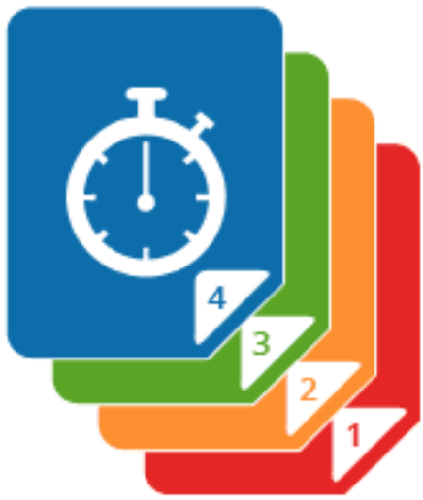
Object Storage: Versioning
Creates multiple versions of the same object.
Prevents accidental deletions by retaining previous versions.
Easy retrieval and restoration of previous versions of objects.
Providing a complete history of changes.
Versioning can be turned on or off
Versioning costs may quickly add up

Slide 20
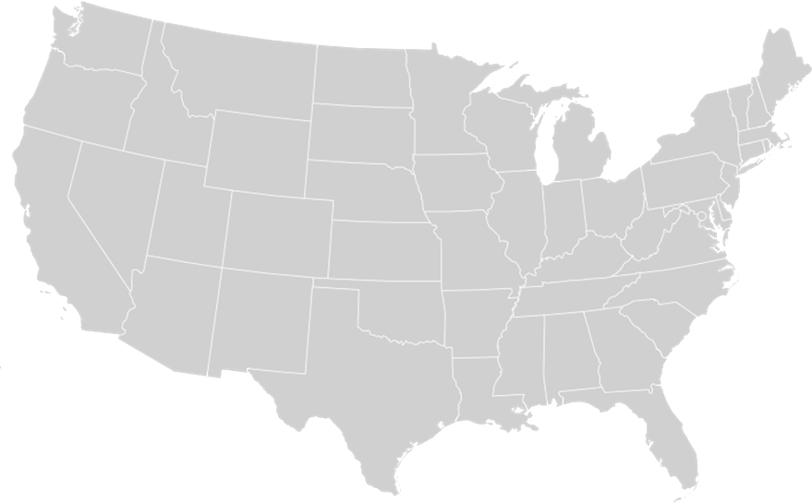


Object Storage: Other Considerations
Regional Pricing
Redundancy
Different regions may have different storage costs
Increasing data availability & resilience will increases cost

Slide 21
Object Storage: Other Considerations
Operations on Data
Network Usage
Operations on data has cost
Avoid operations on cooler storage tiers
Impactful when tied to heavy Read or write applications
Example: running an LS on your bucket with 1 million files would cost
$5.40 ($5 for List and $0.40 for Read)
Minimize data distance
Different regions
Distant geographic locations
AWS: us-east-2 (Ohio)
Azure: North Central US
GCP: us-central1
Operation type | Price per 1K operations
Write | $0.005
List | $0.005
Read | $0.0004

Slide 22
Object Storage Demo

Slide 23
Object Storage: AWS CLI - S3
AWS CLI (Command Line Interface)
To interact with AWS on the command line
Available in Linux, MacOS and Windows
AWS CLI commands to interact with S3
aws s3api : Set of commands mapping to low S3 application programming interface (API)
aws s3 : Set of high level commands to simplify S3 interactions
https://docs.aws.amazon.com/AmazonS3/latest/userguide/setup-aws-cli.html

Slide 24
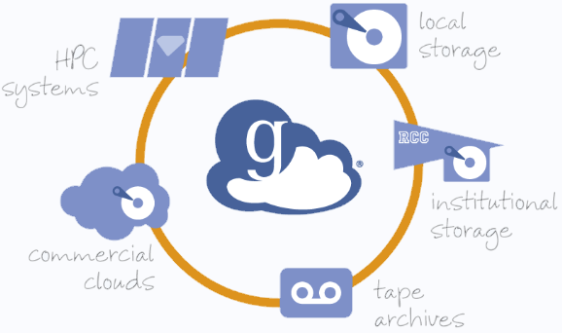
Globus: S3 Connector
Northwestern IT supported tool for transferring and sharing data stored in S3

Slide 25

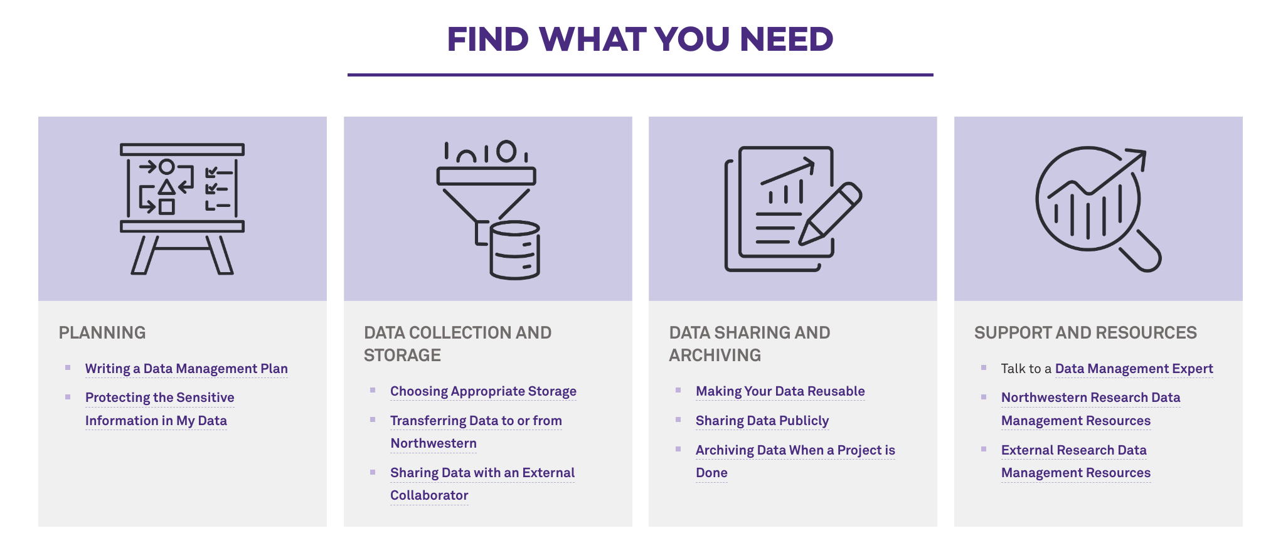
Have more questions?
https://www.it.northwestern.edu/departments/it-services-support/research/data-storage/choosing-appropriate-data-storage.html

Slide 26
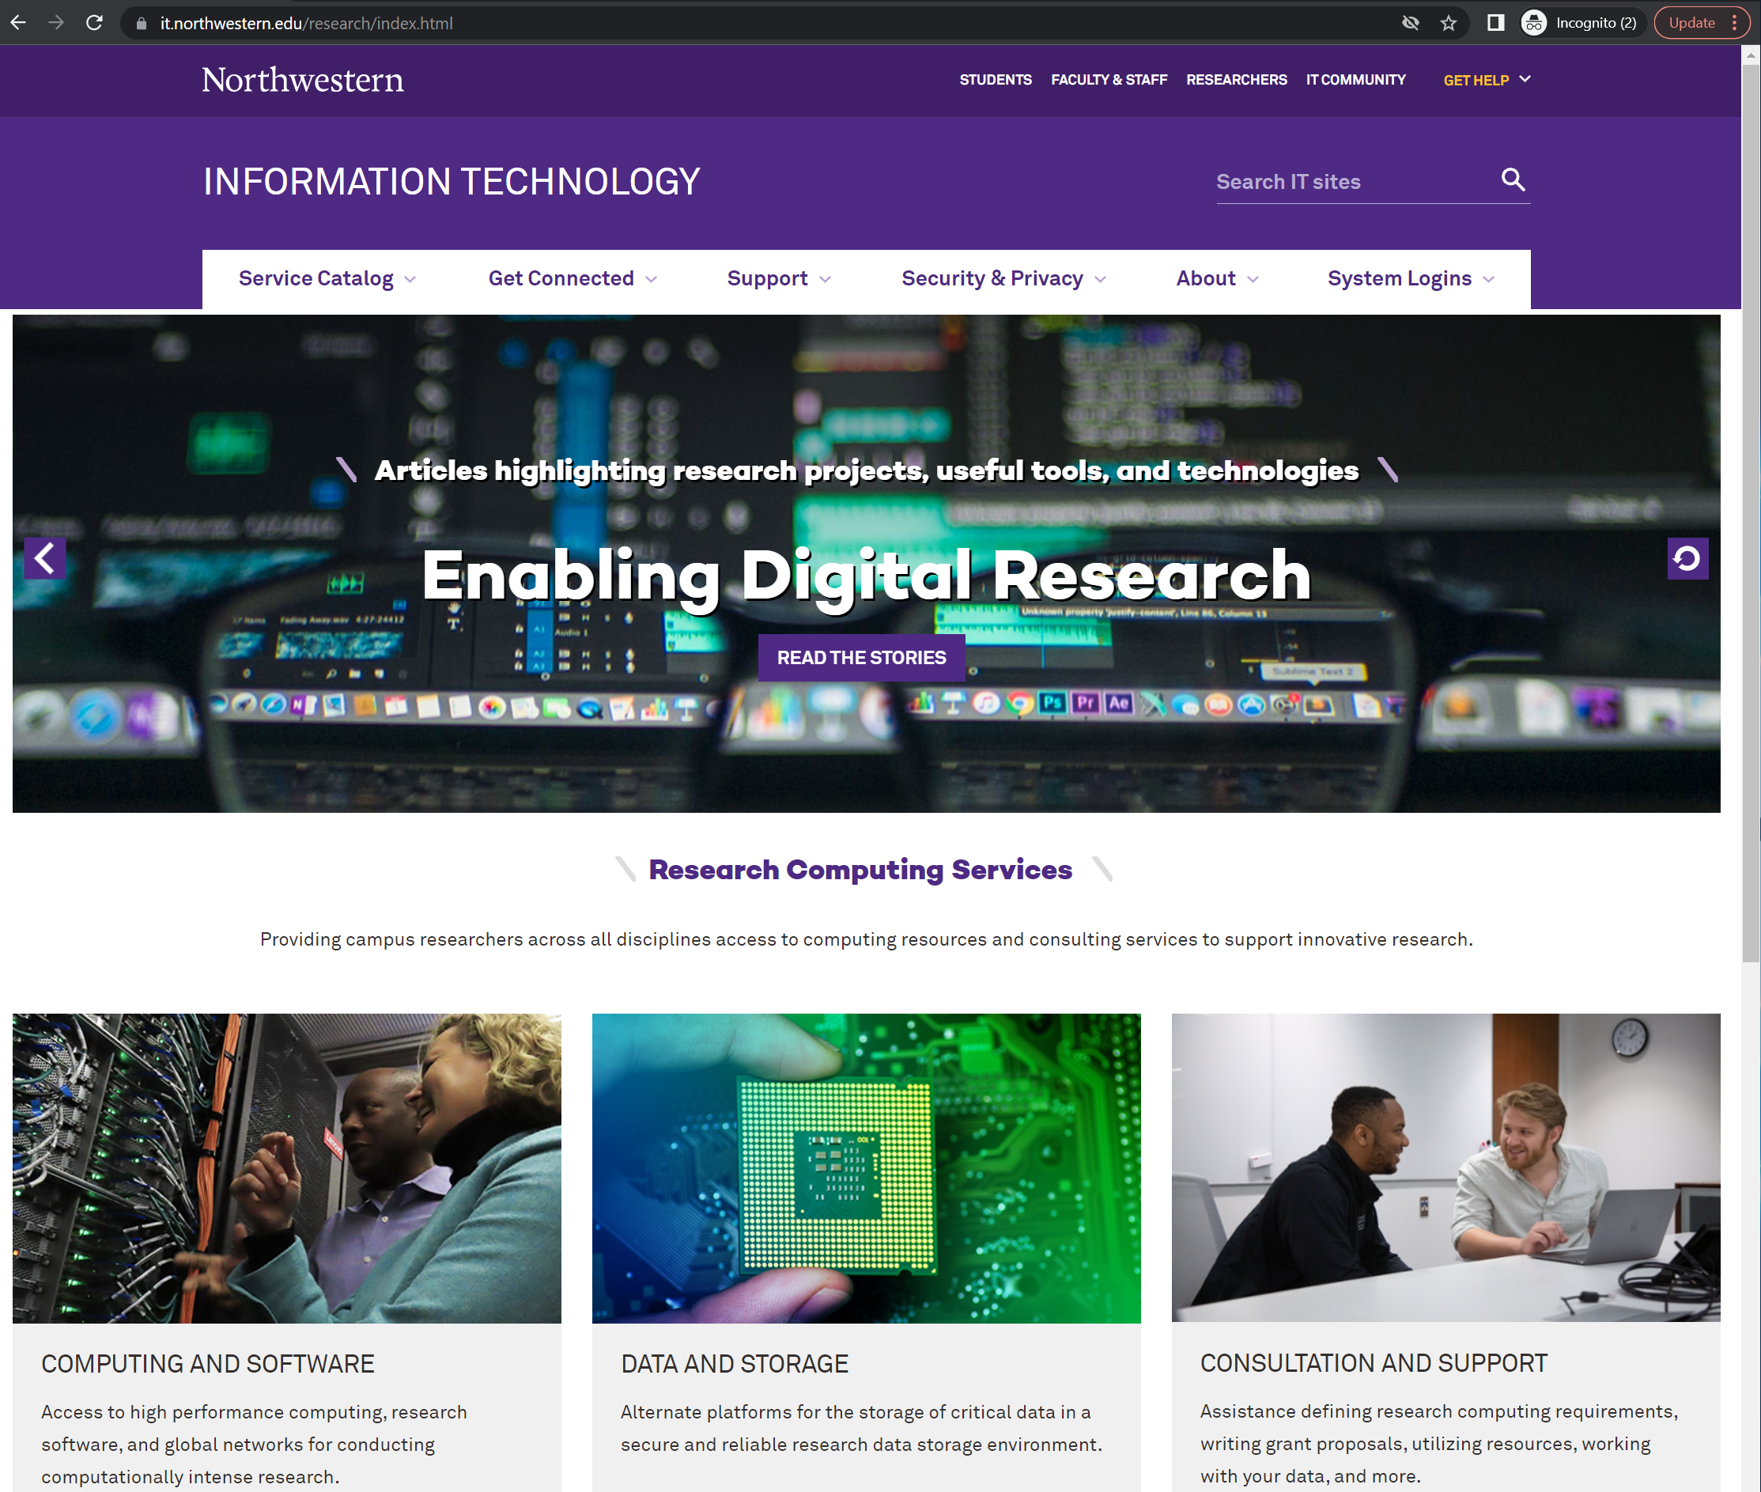
Reach out to RCDS
Research Computing Data Services
Request a consultation to discuss your research needs.
https://www.it.northwestern.edu/research/consultation/index.html

Slide 27

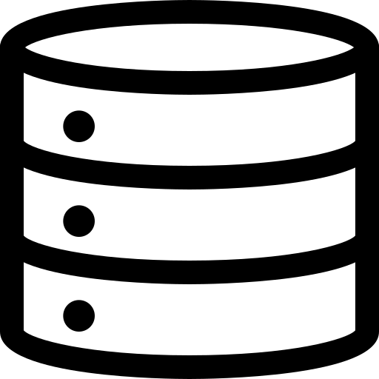

Conclusion
In this workshop we explored
Understand what object storage
Learn the advantages of getting a Northwestern cloud account and how to request one
Creating Bucket and basic configuration
Transferring data via GUI, CLI and Globus.
26

Slide 28
Useful Links:
Northwestern research data management webpage
https://www.it.northwestern.edu/departments/it-services-support/research/
Northwestern IT - Research Computing Services
https://www.it.northwestern.edu/research/index.html
Northwestern IT - Cloud Operations & Public Cloud Accounts
https://www.it.northwestern.edu/service-catalog/infrastructure/cloud-services/public-cloud-services.html
Northwestern Cloud Community of Practice
https://www.cloud.northwestern.edu/resources/cloud-community-of-practice/

Slide 29
Useful Links
AWS S3 documentation
https://docs.aws.amazon.com/AmazonS3/latest/userguide/Welcome.html
Microsoft Azure Blob documentation
https://docs.microsoft.com/en-us/azure/storage/blobs/
GCP Cloud Storage documentation
https://cloud.google.com/storage/docs

Slide 30
Useful Links: Cloud account benefits
Microsoft Azure
https://services.northwestern.edu/TDClient/30/Portal/KB/ArticleDet?ID=1856
Google Cloud Platform
https://services.northwestern.edu/TDClient/30/Portal/KB/ArticleDet?ID=1855
Amazon Web Services
https://services.northwestern.edu/TDClient/30/Portal/KB/ArticleDet?ID=1854

Slide 31
Configuring AWS CLI SSO
SSO session name: nu-sso SSO start URL: https://nu-sso.awsapps.com/start SSO region: us-east-2 SSO registration scopes: Accept default “sso:account:access“
You will configure your profile
Default Region:us-east-2 output format: Text Profile Name: Your Choice
Make your Profile Name memorable
When you run a command, you will need to append the follow to the end of your command.
AWS CLI SSO: Documenation
Configuring SSO
aws configure sso
--Profile <Profile Name>

